Slide 1
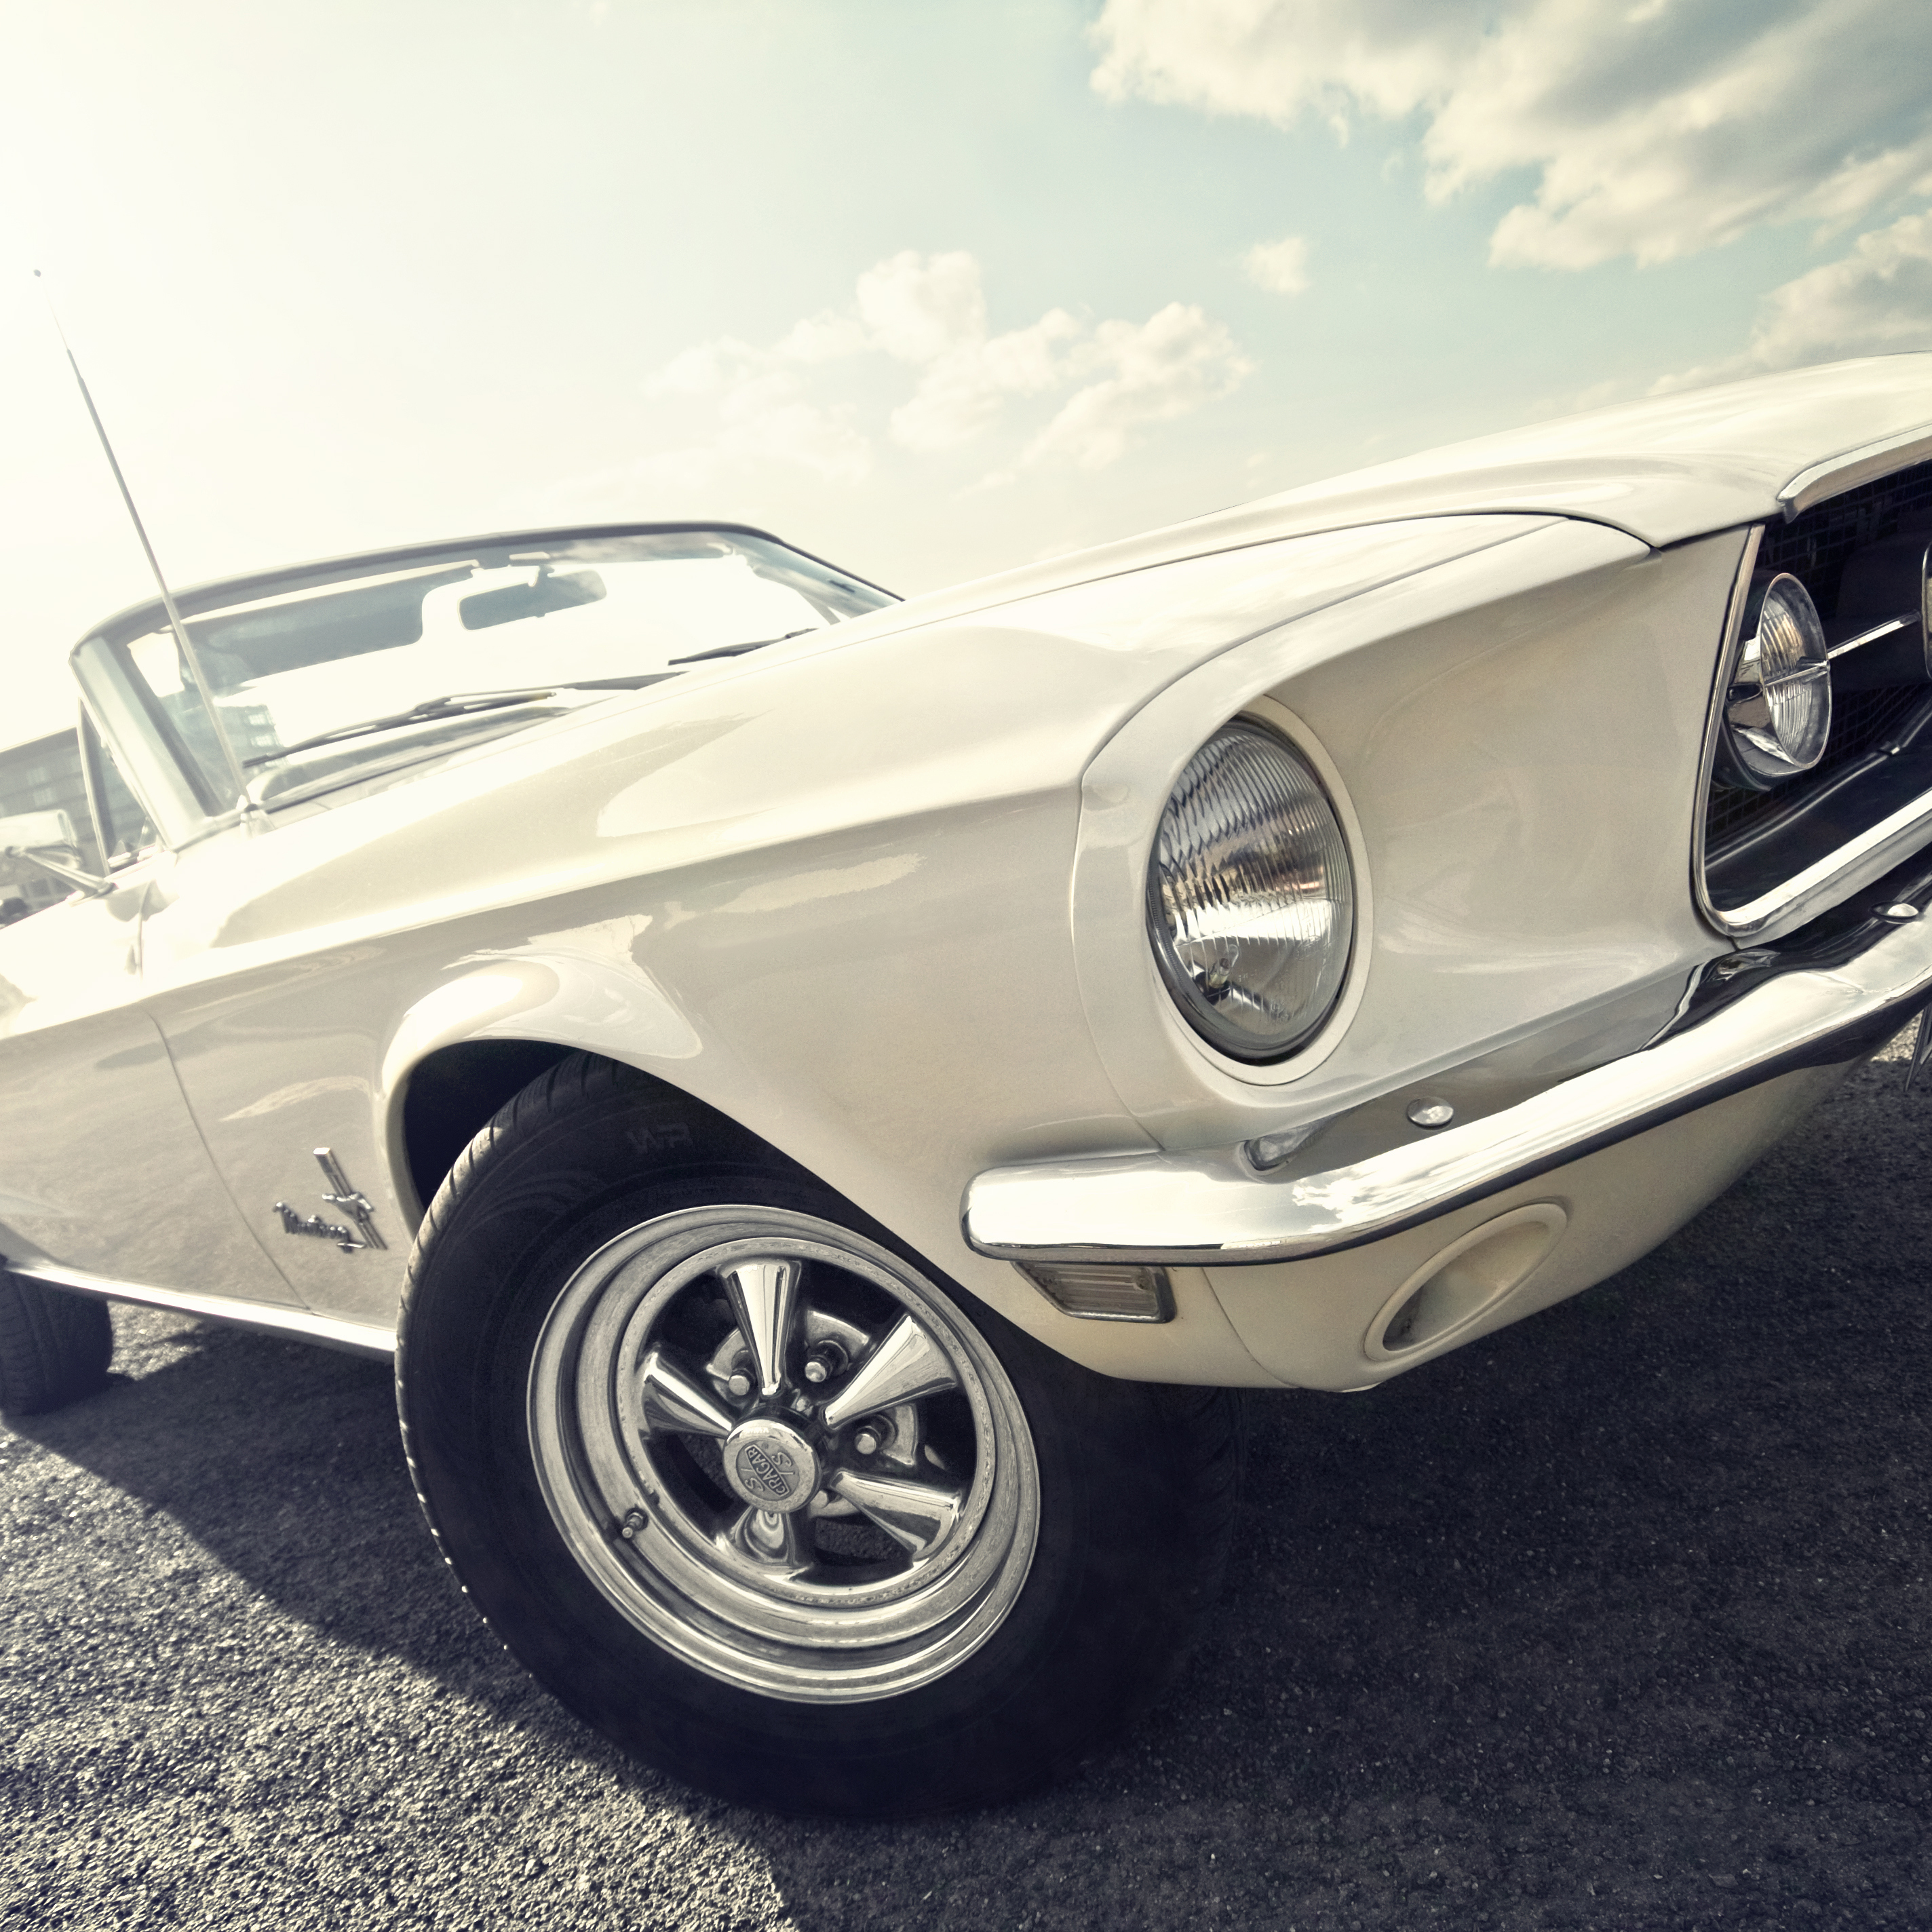
Car price prediction
Divendra Raj

Slide 2
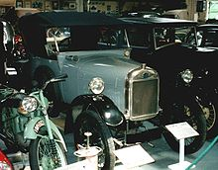
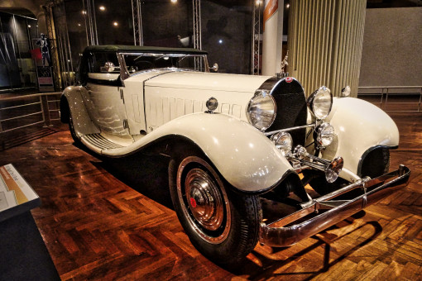
Agenda
Business Background
Business Main Objective
Data Pipeline
Data Summary
Exploratory Data Analysis
Modelling
Model Performance
Interpretations
Conclusion
This Photo by Unknown Author is licensed under CC BY-SA

Slide 3



Background Over the years, technology has changed a lot including adding new CAR design and features. Now days the demand for cars are increasing and with added features, it also drives the price for the cars.
Business Objective
It is possible to predict the price of the vehicle?

Slide 4


About the Data This data is from sourced from Kaggle Project and it is about different Brands of vehicle sold from 1989 to 2022 in Australia. Detailed each vehicle with individual features.
The dataset had 15 features from 59 different brand of vehicle. 5 were Numerical and 10 Categorical features
This modeling was done only on Toyota vehicle of interest.
Upon Exploring the data Variant and Series features were dropped because of inconsistent data.
Some of the incorrect spelling were corrected and two incorrect color column items were dropped.
Data was standardized and scaled before modelling were done.

Slide 5
Data Pipeline
Data Acquisitions
Downloaded data from Kaggle Project
Data Exploration and Statistical analysis
Standardized and scaled the data. One hot coding
Data modeling
Used mean MSE and MAE to check for the errors, test accuracy
Outcome
Plotted models compared actual and predicted and test results
Conclusion
Target to validate and include dropped features to see the performance
Data Preprocessing
Testing the Models
Explored the data – Plot the bar graph to study the market
Support Vector Regressor, K Nearest Regressor, PLS Regression, Decision Tree Regressor, Gradient Boosting Regressor, MLP Regressor

Slide 6

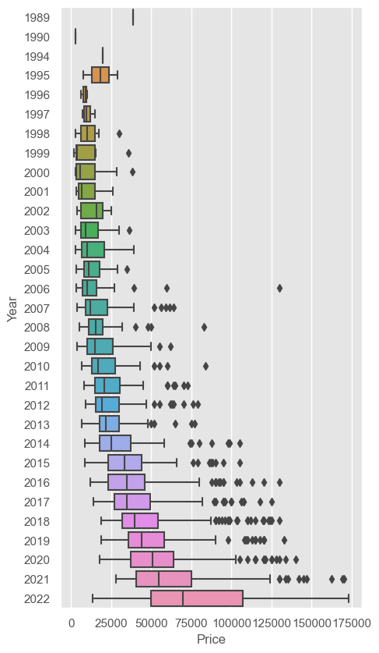
Exploratory Data Analysis
Outliers
There were lots of outliers which needed lot of feature engineering and normalisation

Slide 7
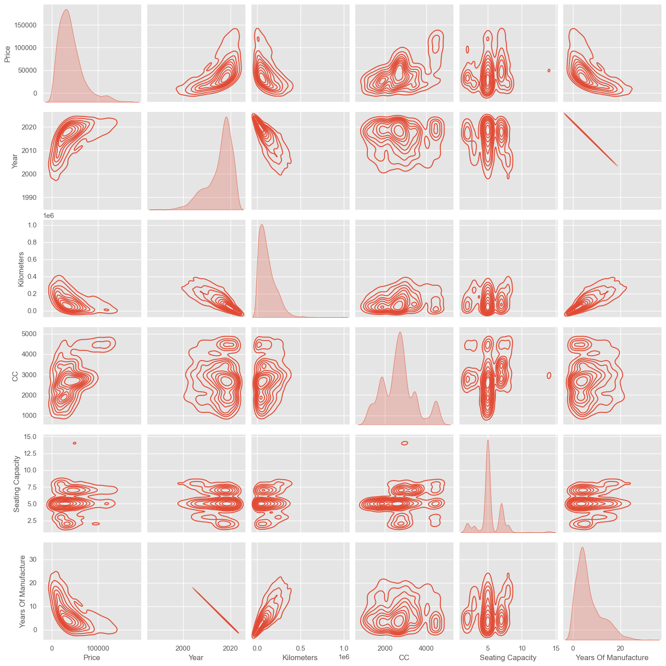
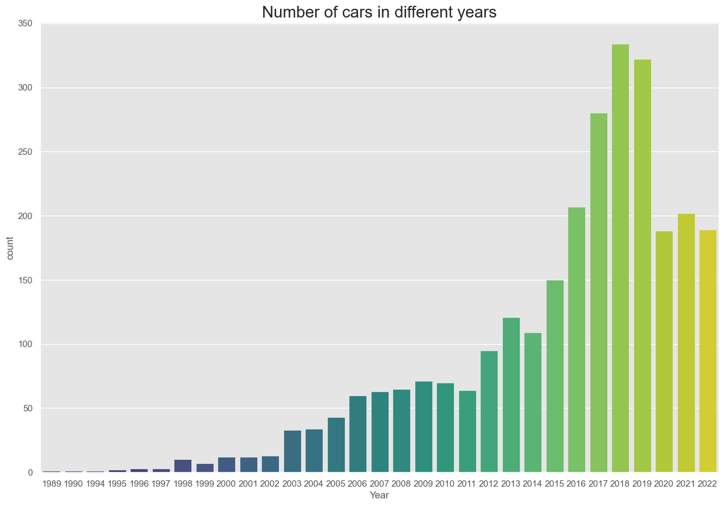
Exploratory Data Analysis
Feature relations
With the numeric features on the right, YEARS, CC had high positive but KILOMETERS had high negative effect on PRICE which was our target variable
Consumer Demand
The demand for vehicle grew over the recent years however this was slowed down from 2020, maybe due to effect of the lockdowns.

Slide 8
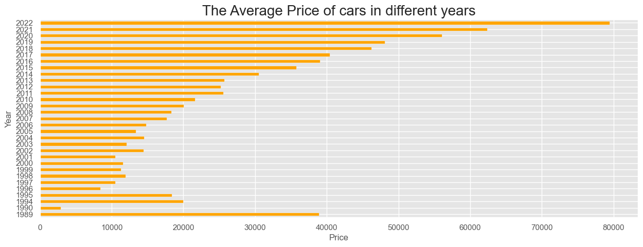
Average vehicle Price Below plot show the average price of the vehicle over the years. According to the graph year 2022 had the biggest boost in price compared to other years

Slide 9
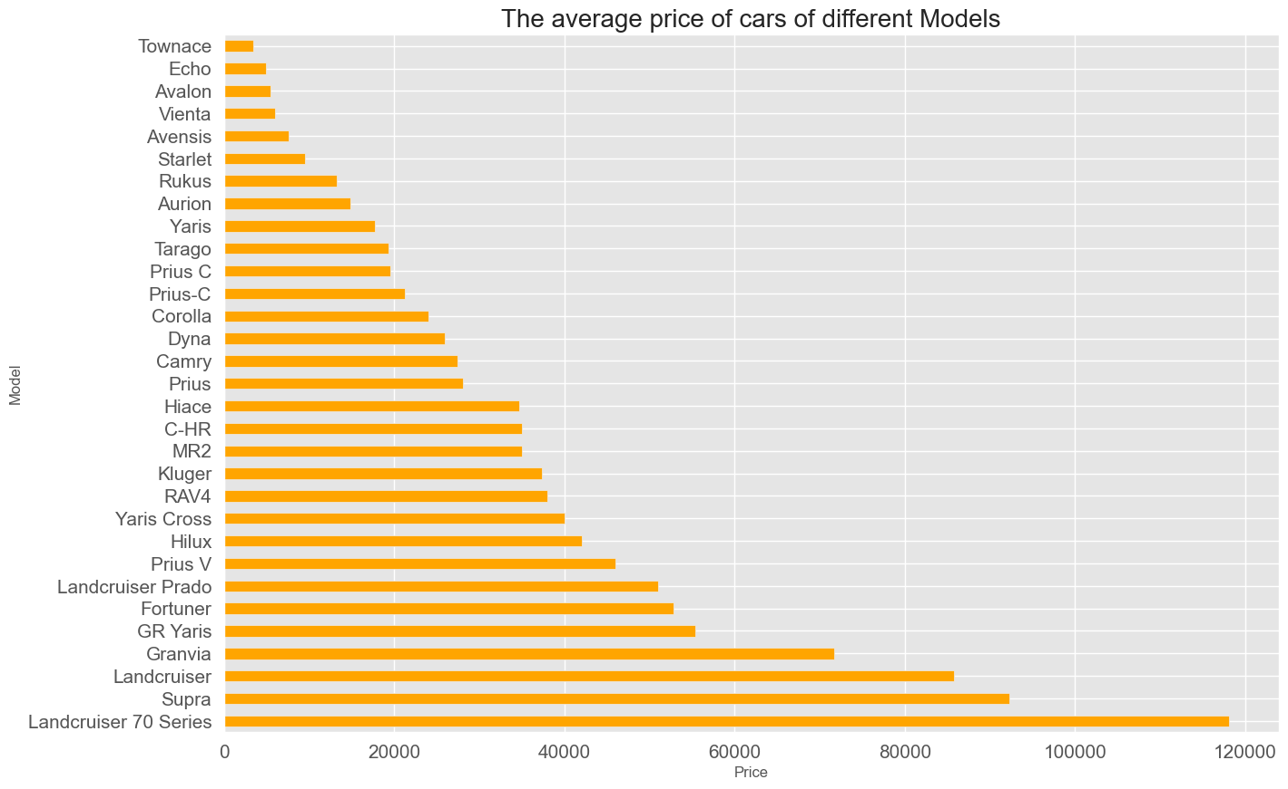
Average Vehicle Model Price According to the graph placement below different models have different price and it varies quite a lot though they are same Brand but different Models. Price ranges as low as $2000 to high $120,000.

Slide 10
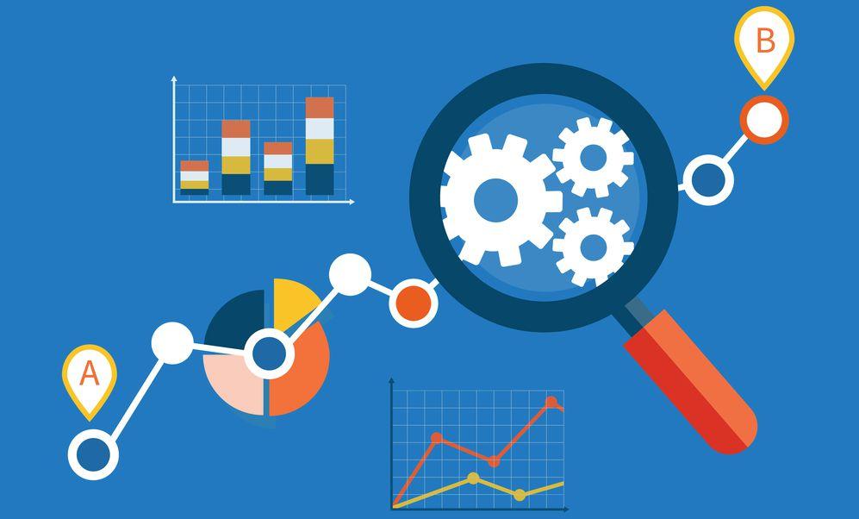
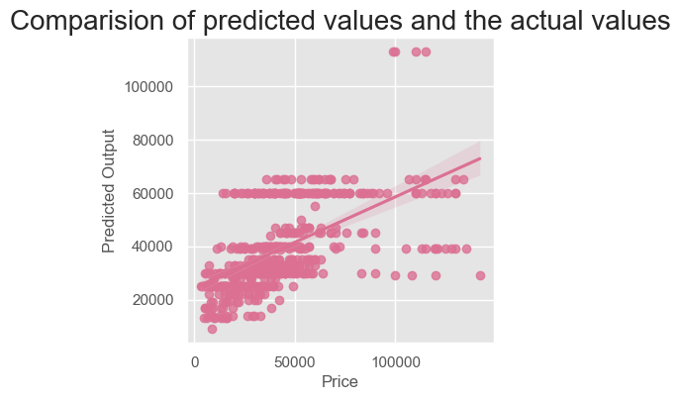
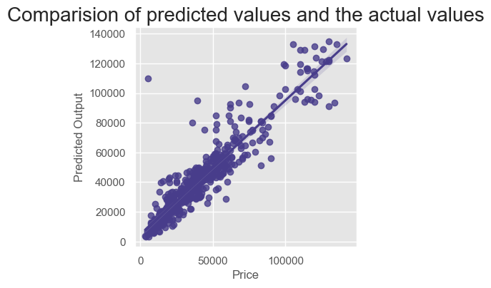
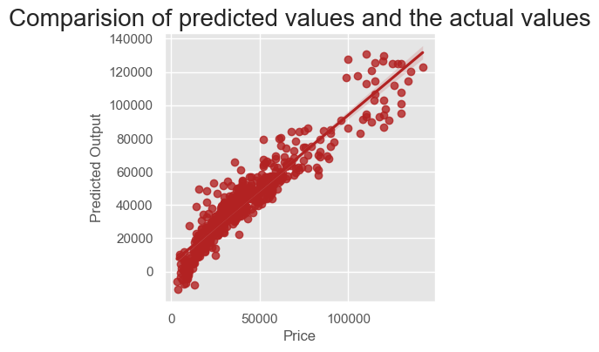
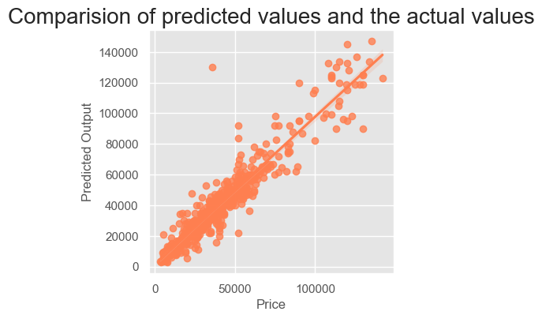
Model Outcomes: The data were split into 80% training and 20% test 6 different models were used to predict the output and were plotted on the graph to compare with actual Price of the vehicles.
Support Vector Regressor
KNN Regressor
PLS Regressor
Decision Tree Regressor

Slide 11
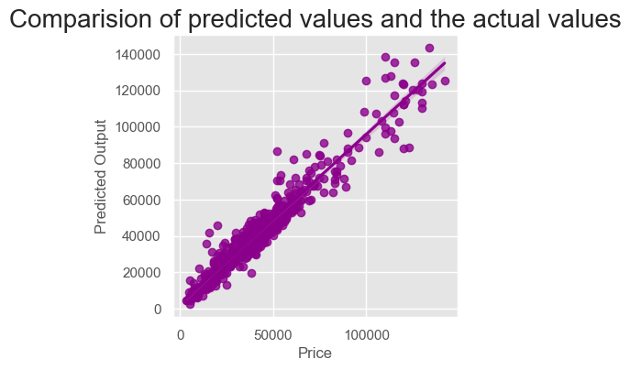
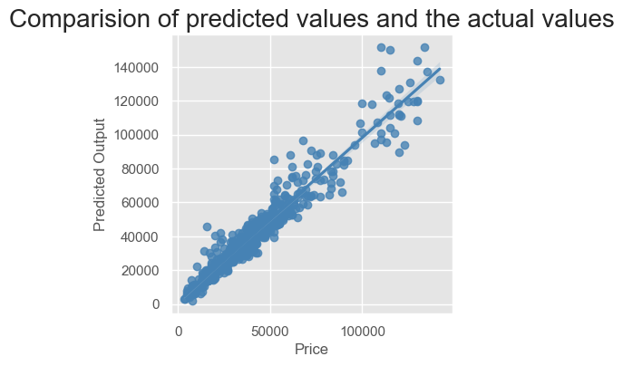
Model Outcomes: 6 different models were used to predict the output and were plotted on the graph to compare with actual Price of the vehicles.
Gradient Boosting Regressor
MSP Regressor

Slide 12
Model Performance and Testing On the right is the model performance test outcomes which show except for Support Vector Regressor all other model performed well according to the TEST ACCURACY scores.
 | Models | Mean Absolute Error | Mean Squared Error | Accuracy Rate(%)
0 | Support Vector Regressor | 14448 | 494129830 | 0.0183
1 | K Nearest Regressor | 6342 | 107531877 | 0.8536
2 | PLS Regression | 6616 | 80881605 | 0.8899
3 | Decision Tree Regressor | 5524 | 79938058 | 0.8912
4 | Gradient Boosting Regressor | 4699 | 46781066 | 0.9363
5 | MLP Regressor | 4810 | 51680045 | 0.9297

Slide 13
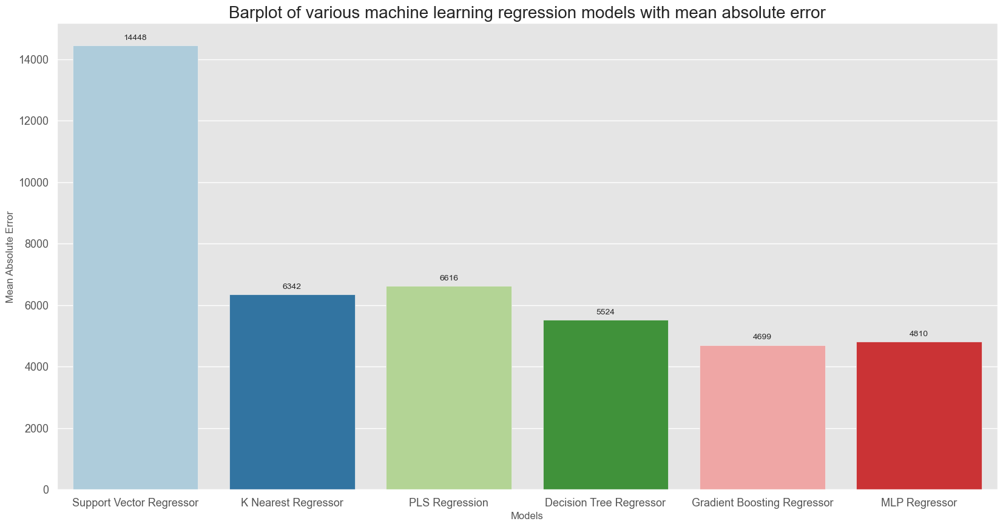
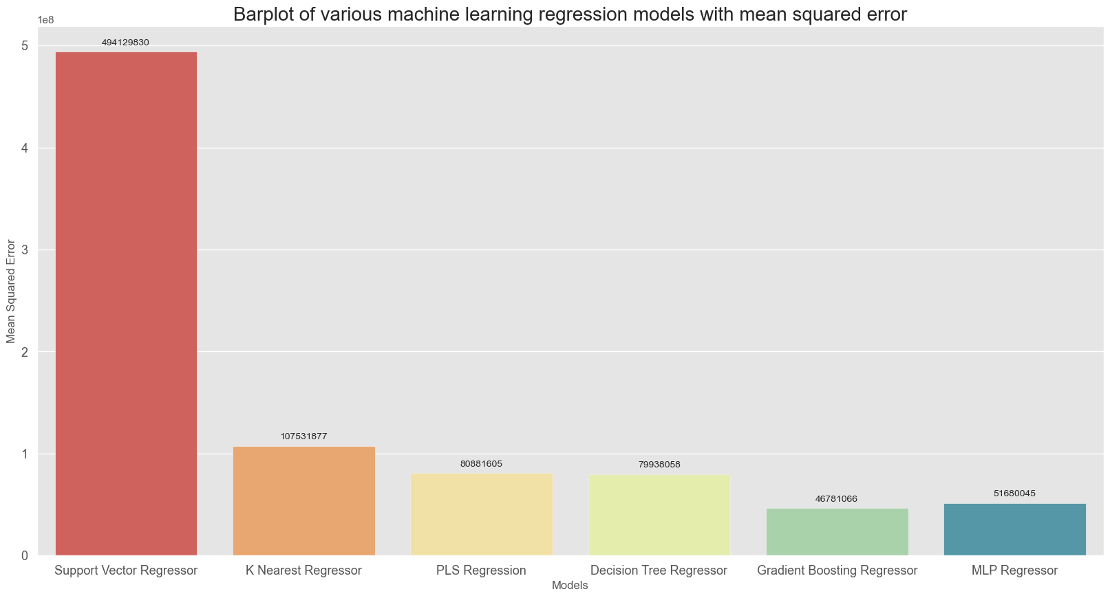
Performance and Recommendation Based on the performance Gradient boosting and MLP Regressor made less errors based on the prediction. Support vector mean error was the highest at this point of performance compared to other models however other model testing and feature testing would can be done before deploying the model. The business question was answer is YES, we can use models to predict the price of the vehicle. Next step is to add more features based on the low- and high-end vehicles.

Slide 14


THANK YOU

